Slide 1
Introduction to TCP/IP networking

Slide 2
TCP/IP protocol family
IP : Internet Protocol
  UDP : User Datagram Protocol
    RTP, traceroute
  TCP : Transmission Control Protocol
    HTTP, FTP, ssh

Slide 3
TCP/IP Network Model
Five network “layers”
  Layer 1 : Physical – cables
  Layer 2 : Data Link – ethernet
  Layer 3 : Network – IP
  Layer 4 : Transport – TCP/UDP
  Layer 5 : Application

Slide 4
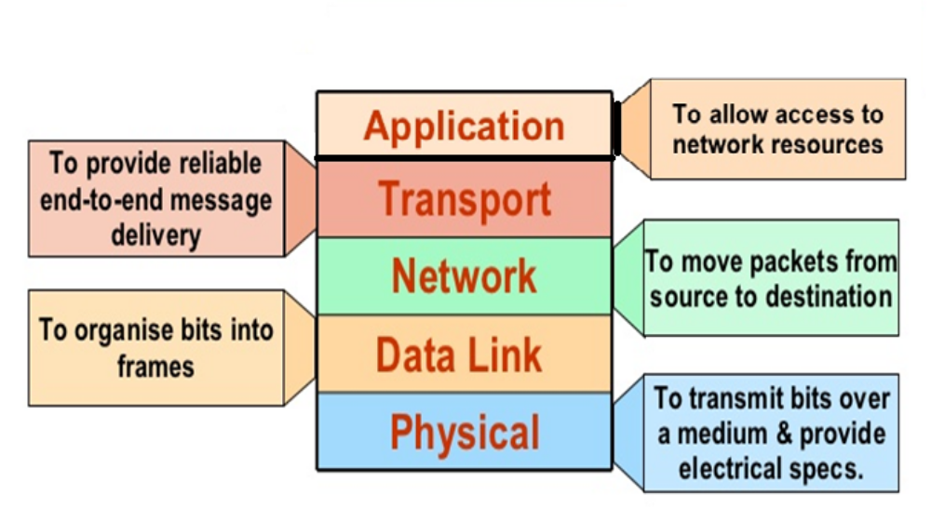
OSI Moel

Slide 5
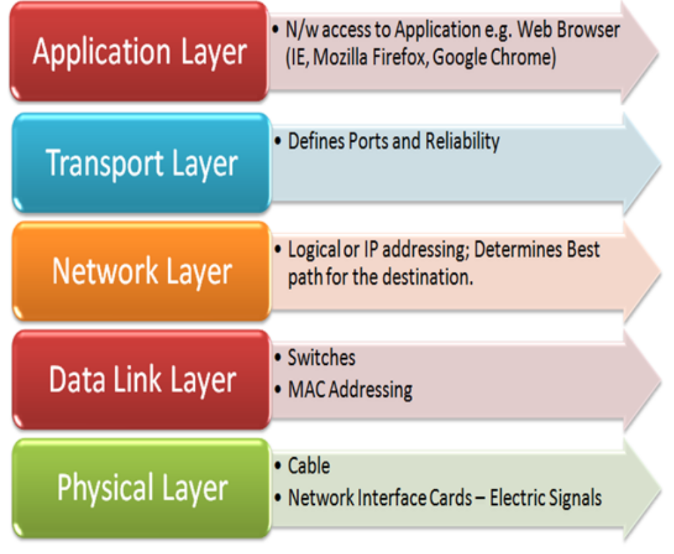

Slide 6
TCP/IP Network Model
Different view – 4 layers
  Layer 1 : Link (we did not look at details)
  Layer 2 : Network
  Layer 3 : Transport
  Layer 4 : Application

